Slide 1

Employee Attrition
Presented by: Aboagye Michael

Slide 2

Overview
One of the main problems faced by companies is employee attrition, this is caused by several factors. According to the data, close to 17% of employees has left the company.
In this presentation we will be covering the most prior reason why employees are leaving the company.
At the end we will suggest ways to combat or reduce the problem of employee attrition.

Slide 3

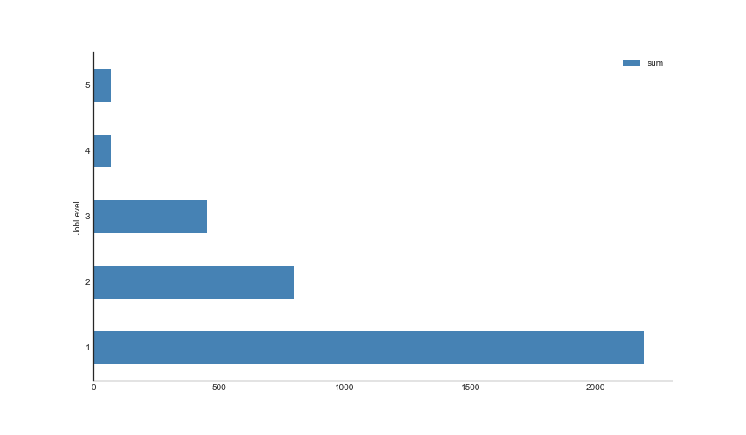
Salary Hike and Monthly Income
From the chart,
In total, the salary hike of the employees increases as the job level lowers.
This is the opposite when it comes to Monthly Income. It increases as the Job Level Increases.

Slide 4

Business Travel
From the data,
67% of the employees that left the company never had a business travel, and they were from the Research and Development department.
33% was from the Sales Department.

Slide 5

Employee Satisfaction
53% of the employees that left had high job involvement. 11% of the employees had low job involvement.
But it seems the median monthly income of these employees are closely the same.

Slide 6

Work Environment
According to the data,
30% of the employee who left the company had low environment satisfaction. It was higher than the rest of the responds.

Slide 7

Problem with the Manager
Regardless of the Monthly Income and other factors that normally keeps employees in a company. Employees who was leaving the company within period less than 4 years was incredibly higher.
The attrition may be caused by relationship of the employees with the current manager.

Slide 8
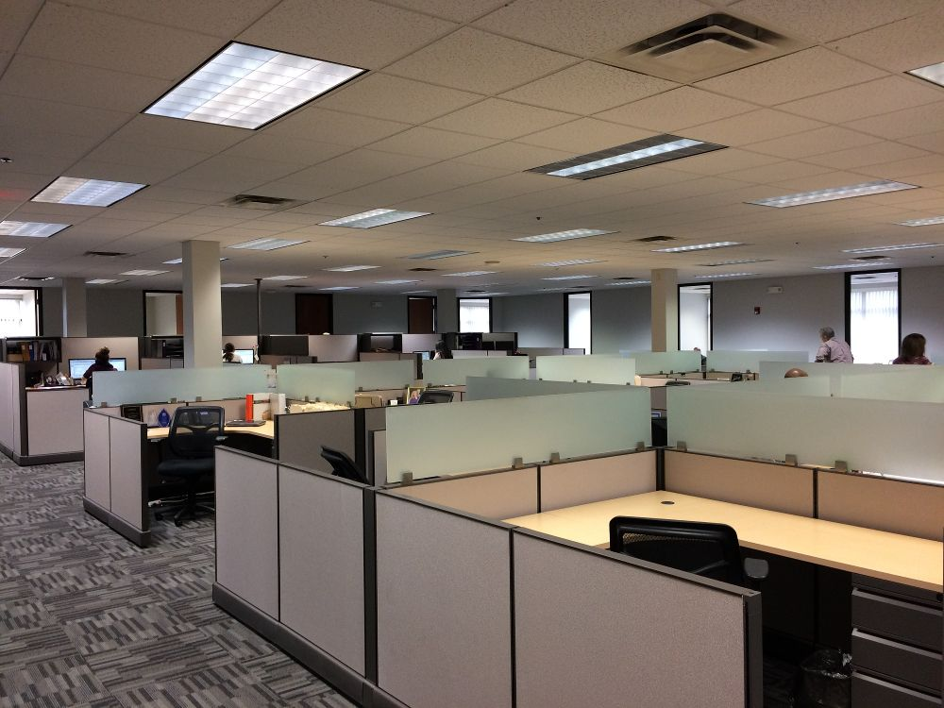
Employee who is likely to leave.
Employee that are under paid .
Employee that does not feel comfortable with the working environment.
Employee that are not comfortable with their manager.
Employee that are discriminated due to their job level or their gender.
Employees from department that requires them to have business travel but don’t get any.

Slide 9

Recommendation
There should be a fair distribution of income to employees of different levels and gender with no discrimination.
The management should consider the well-being of the employees to their priorities.
The company must make sure the environment the employee at working in are conducive enough.

Slide 10

End of Slides

